Slide 1
Module 5: Asynchronous Actions
SER 423

Slide 2
Overview
Most statements within a program are executed synchronously
This means that they run sequentially and a given step cannot start until the previous one finishes
This is separate from context switching within the processor
  Each program is an individual process
Where we run into problems is if we have a bottleneck
  Some step that takes notably longer to complete
If the entire process is synchronous, we have to wait for that longer step to finish before we can start the next step
This can make the program appear to hang or freeze while we wait for that step
If we can make that step run in parallel, we can avoid holding up the entire program

Slide 3
Introducing the Asynchronous Process

Slide 4
What is an asynchronous process?
An asynchronous process is one that executes alongside the main program
You’ve probably heard of this, or at least seen it before as Threading
By delegating a task to another thread, it can be completed while the main thread continues
Essentially, this removes the previous problem of the program not being able to continue while it waits for a given step
On the main thread, there is a step to start the asynchronous process, then the next step starts immediately
When the asynchronous process completes, it will use a call back function to alert the main thread that it has completed

Slide 5
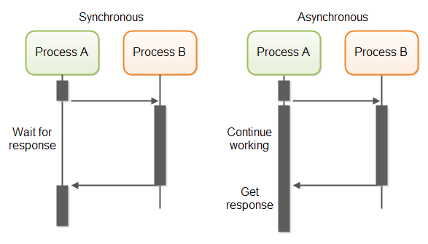
Visualization of This Process
From: https://medium.com/from-the-scratch/wtf-is-synchronous-and-asynchronous-1a75afd039df

Slide 6
Why would we use this?
Take a moment to think about this process and why we would use it. Try to write down two or three reasons to use it.

Slide 7
Reasons to use an Asynchronous Process
There are several places where using an asynchronous process is a good idea
Again, it’s any situation where we do not want the entire program to be held up by one long step
So what are some examples of where we would use this?
  Retrieving data from the web
  Loading a (large) image
  Searching a large database
These are some of the most common examples
  There are plenty of others
The first one, retrieving data from the web, is common enough that we will have an entire Module on it
Network connectivity might be limited, results could take awhile to return

Slide 8
How Often do we use these?
Asynchronous processes are actually extremely common in mobile development
  Both Google and Apple have made it clear that the UI in an app should NEVER hang and appear unresponsive for any reason
Since the UI always executes on the main thread, we want to off load heavy tasks to another thread to keep the main thread lightweight
Both Android and iOS have several built in tools to help support using asynchronous tasks
React of course has them as well and we’ll look at those next time.
There is also a deep matter of the JavaScript thread compared to the Native thread, but we’ll go in depth on that later as well

Slide 9
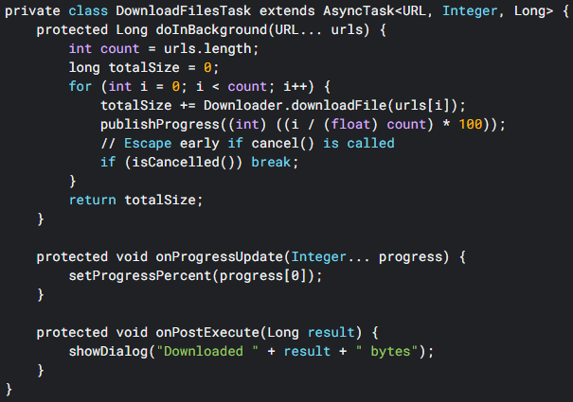
Quick Old Android Example

Slide 10
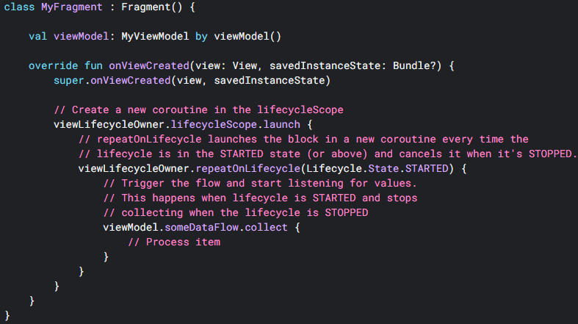
Quick Kotlin Example

Slide 11
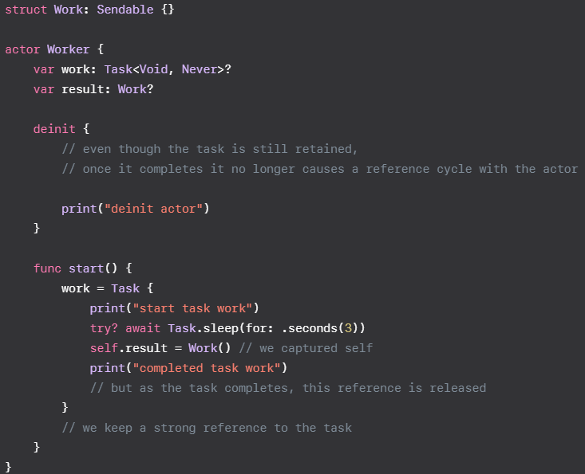
Quick iOS Example

Slide 12
End of Intro to Asynchronous Actions
Next Time - How to do this in code

